Slide 1



Ahsanullah University of Science and Technology
Design Variable Frequency Drive
30 Hz to 55 Hz
Presentation - 2023
Group Members:
190205088
190205089
190205090
190205093
190205096
www.aust.edu

Slide 2
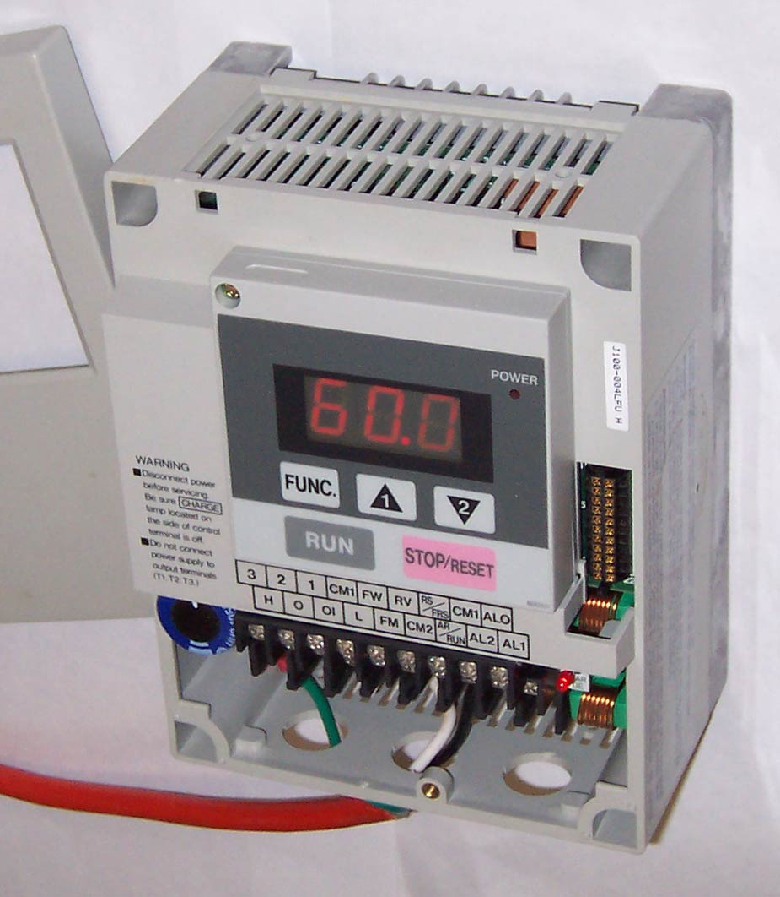
Introduction
Our project centers around the design and implementation of a Variable Frequency Drive (VFD).
Here In this presentation ,we will see how we have designed the project. The components that we used and what are the functionalities of them. The circuit diagram and finally we will practically observe the change of frequency ranging 30 to 55HZ through multimeter.

Slide 3





Project Objectives:
Variable Frequency Control
Demonstrate Functionality
Develop a functional Variable Frequency Drive (VFD) capable of smoothly varying the frequency of the output signal within the specified range of 30 Hz to 55 Hz.
Showcase the successful operation of the designed VFD by connecting it to a motor and illustrating its ability to control the motor's speed effectively across the desired frequency spectrum.
Component Integration
Energy Efficiency
Integrate the 220V/12V center-tap transformer, CD4047BCM oscillator, L7812CV voltage regulator and IRF540 power transistor seamlessly to create a cohesive VFD system.
Highlight the energy-saving potential of the VFD by effectively regulating motor speed based on load requirements, emphasizing its practical implications for reducing power consumption.
Educational Value
Provide a clear and educational demonstration of the principles behind variable frequency motor control using accessible components, contributing to a deeper understanding of power electronics concepts.

Slide 4

Components Used:
220V/12V center-tap transformer
L7812CV voltage regulator
CD4047BCM oscillator
IRF540 power transistor
Potentiometer
Resistors , capacitors and diodes.
Breadboard
Wires and connectors

Slide 5
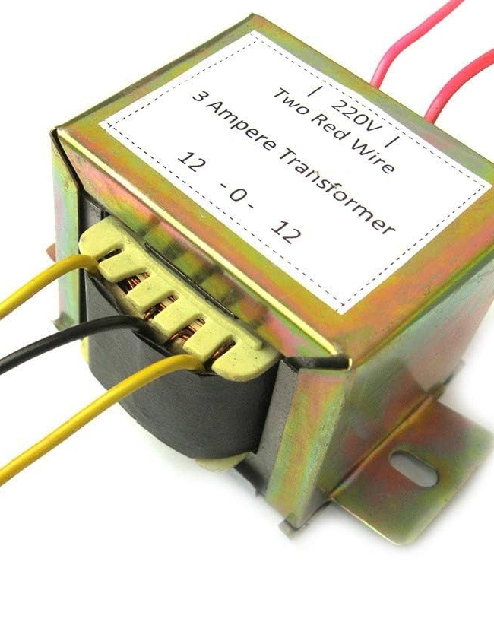
220V/12V center-tap transformer
The use of a 220V/12V centre-tap transformer is significant because it provides voltage transformation, electrical isolation, safety, and compatibility with the components in VFD circuit. It plays a critical role in creating the necessary voltage levels and configuration for the successful operation of your VFD system.

Slide 6
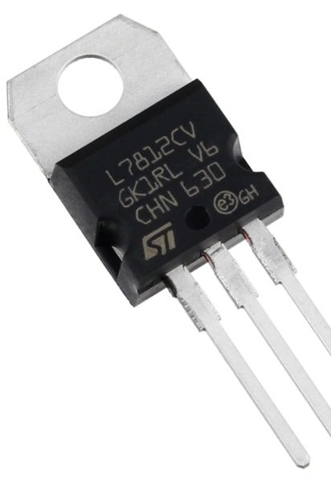
L7812CV voltage regulator
The L7812CV voltage regulator plays a significant role in various electronic circuits due to its ability to provide a stable and regulated output voltage of +12 volts. The primary function of a voltage regulator is to stabilize the output voltage regardless of variations in the input voltage and load conditions. The L7812CV ensures that the output voltage remains at a consistent +12 volts even if the input voltage fluctuates.

Slide 7
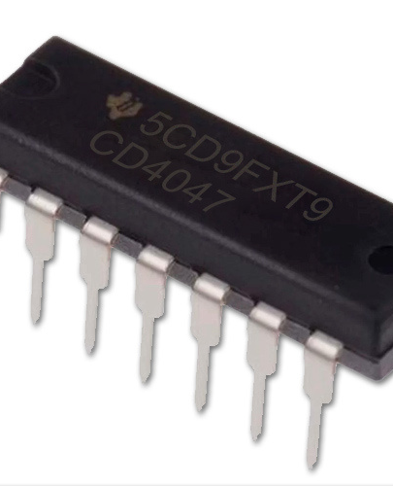
CD4047BCM Oscillator
The significance of using the CD4047BCM oscillator in your Variable Frequency Drive (VFD) project lies in its ability to generate precise and adjustable square wave signals, which are essential for controlling the frequency of the output signal. The CD4047BCM oscillator can be configured to produce square wave output signals with a frequency that can be adjusted by external components. This is crucial for your VFD, as it allows you to set the desired output frequency within the specified range of 30 Hz to 55 Hz.

Slide 8
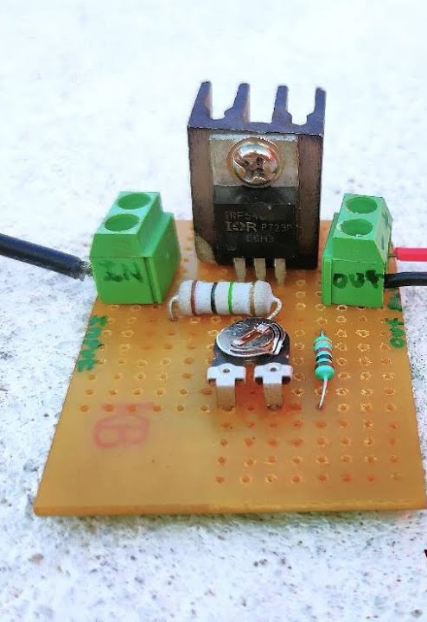
IRF540 MOSFET
The IRF540 MOSFET's high voltage and current handling capabilities, efficient switching characteristics, compatibility with PWM control, thermal efficiency, robustness, reliability, cost-effectiveness, and versatility make it a suitable choice for controlling the output in the Variable Frequency Drive project. Its attributes align well with the requirements of motor control systems, ensuring optimal performance and accurate frequency adjustments.

Slide 9

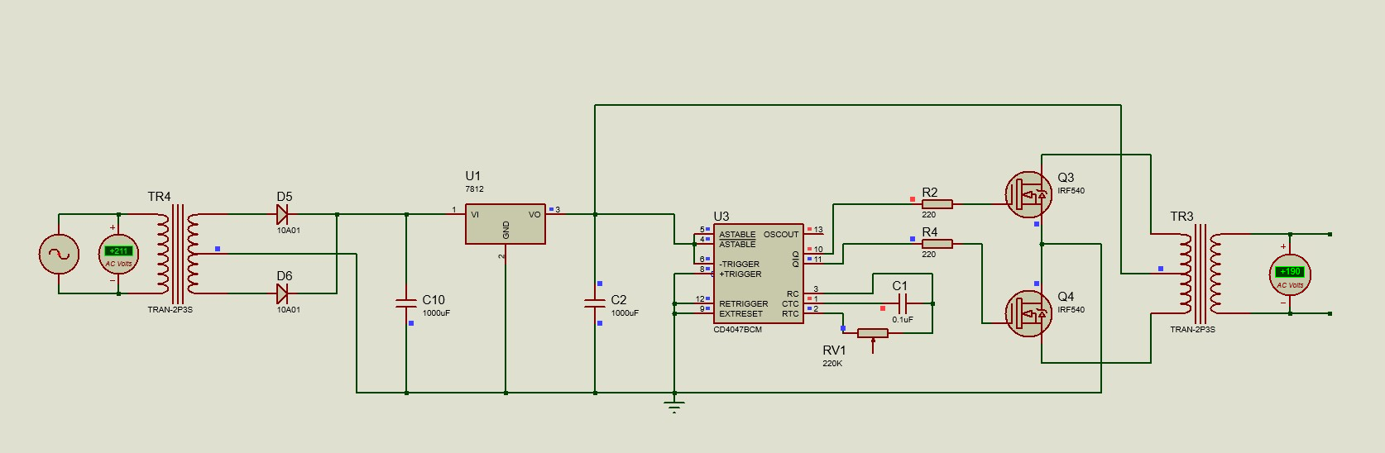
Proteus Simulation Diagram of VFD

Slide 10


Slide 12




Advantages and Benefits of VFD Implementation
Energy Efficiency
Reduced Wear and Tear
Soft Starting

Slide 13
Advantages and Benefits of VFD Implementation
Precise Process Control
Adaptability to Variable Loads
Cost Savings

Slide 14

Limitations and Considerations in the Variable Frequency Drive (VFD) Design

Slide 15
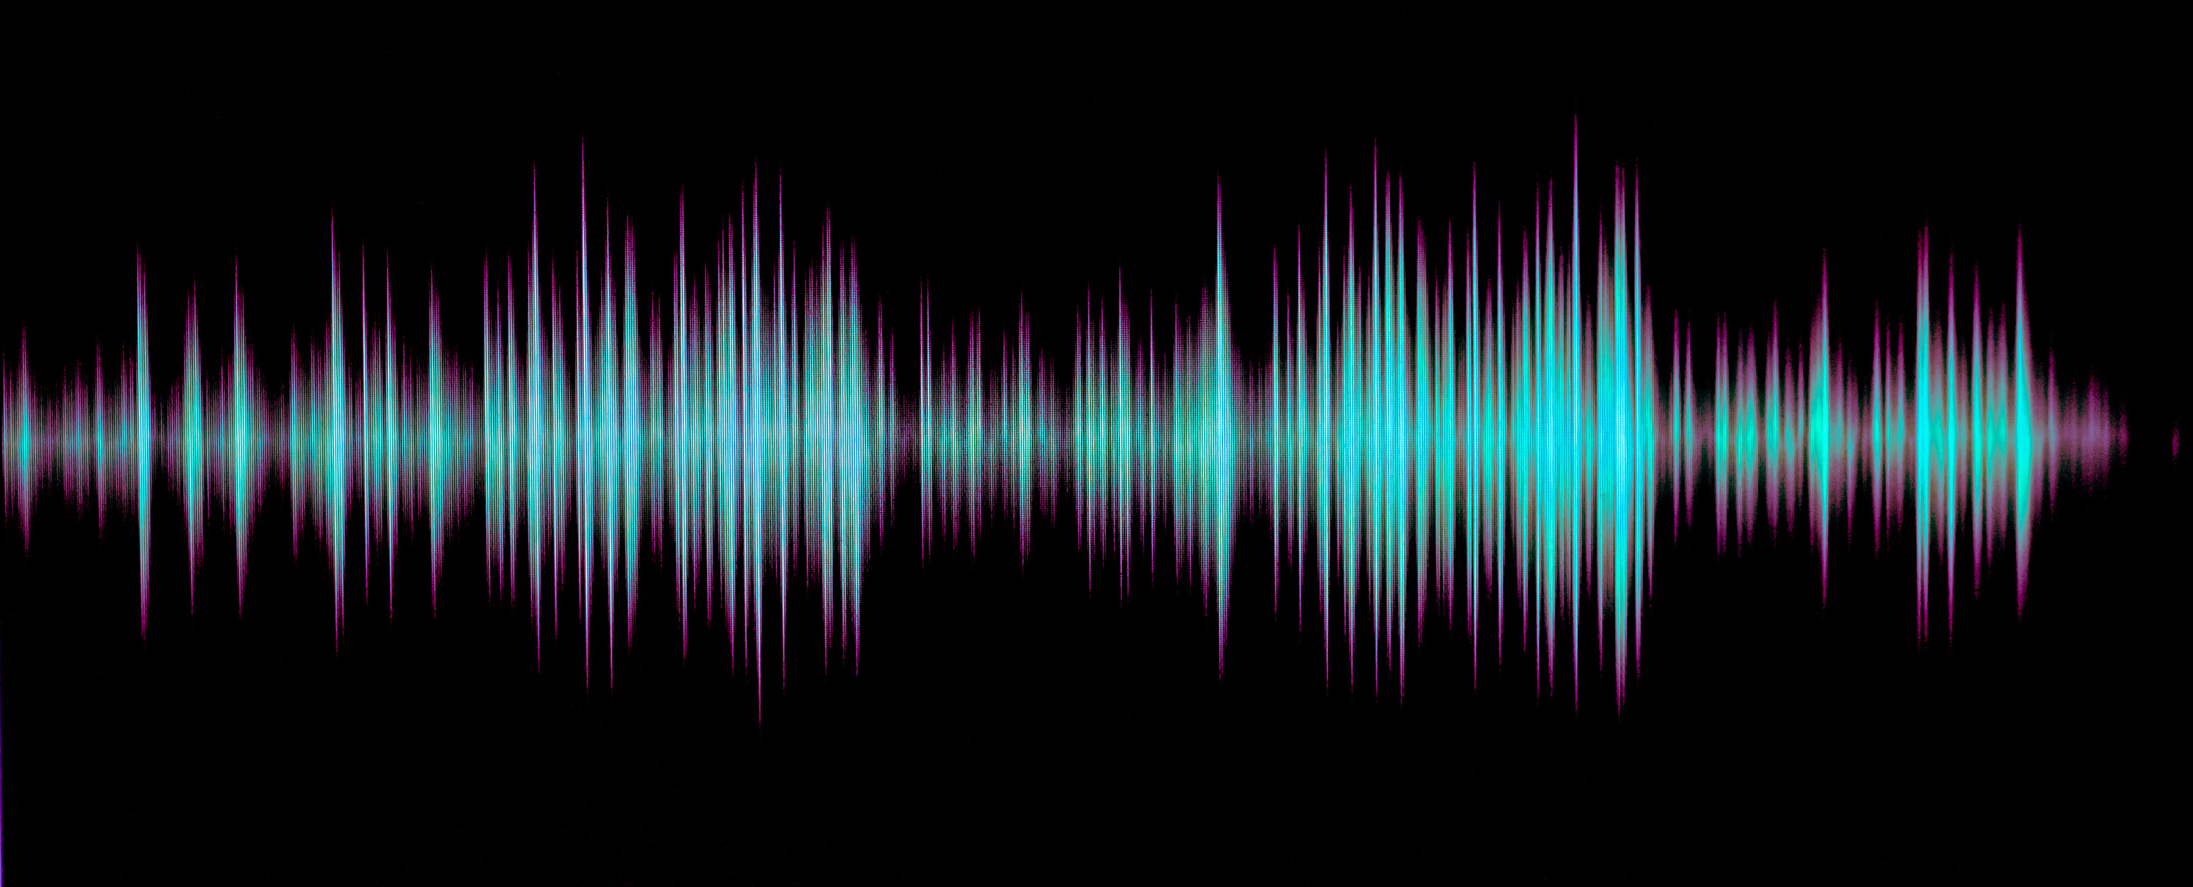
Frequency Range Constraints
The designed VFD is limited to the specified frequency range of 30 Hz to 55 Hz. This range might not cover all potential applications or specific motor requirements, which could limit its versatility in certain scenarios.

Slide 16
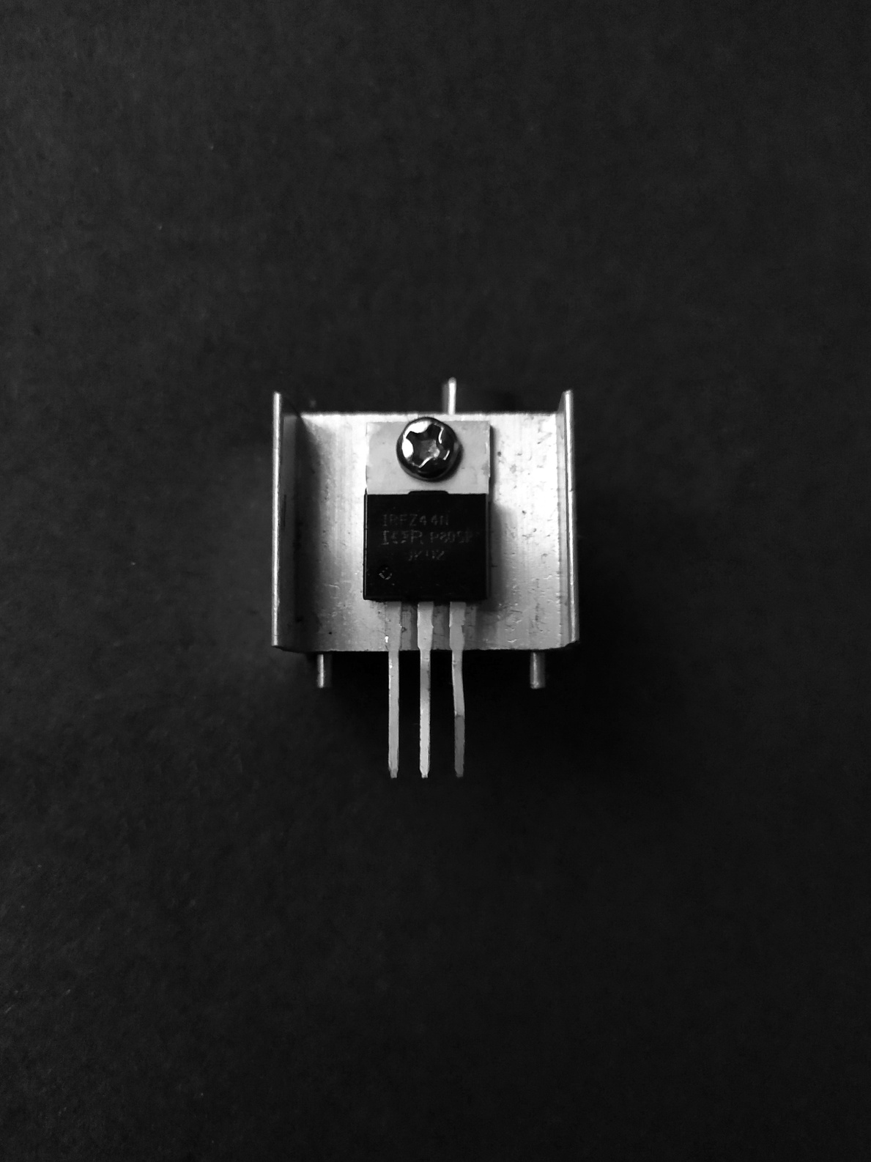
Limited Power Handling
The chosen components, including the IRF540 MOSFET, have specific power ratings. If the application requires higher power handling, there might need to select more powerful components or design additional protection circuits.

Slide 17

Lack of Closed-Loop Control
The project might lack a closed-loop feedback system that adjusts the output frequency based on actual motor speed. This means that the VFD's speed control might not be as accurate or responsive under varying loads.

Slide 18

The Future Trajectory of Variable Frequency Drive (VFD) Advancements
The project's future holds promising prospects for further refinement and innovation. Enhancements could include advanced control algorithms for precise speed regulation, integration of closed-loop feedback systems, exploration of higher-power components, and the implementation of digital interfaces for remote monitoring and data analysis. This project could serve as a foundation for broader applications in industrial automation, energy-efficient motor control, and the development of intelligent, adaptable control systems.

Slide 19
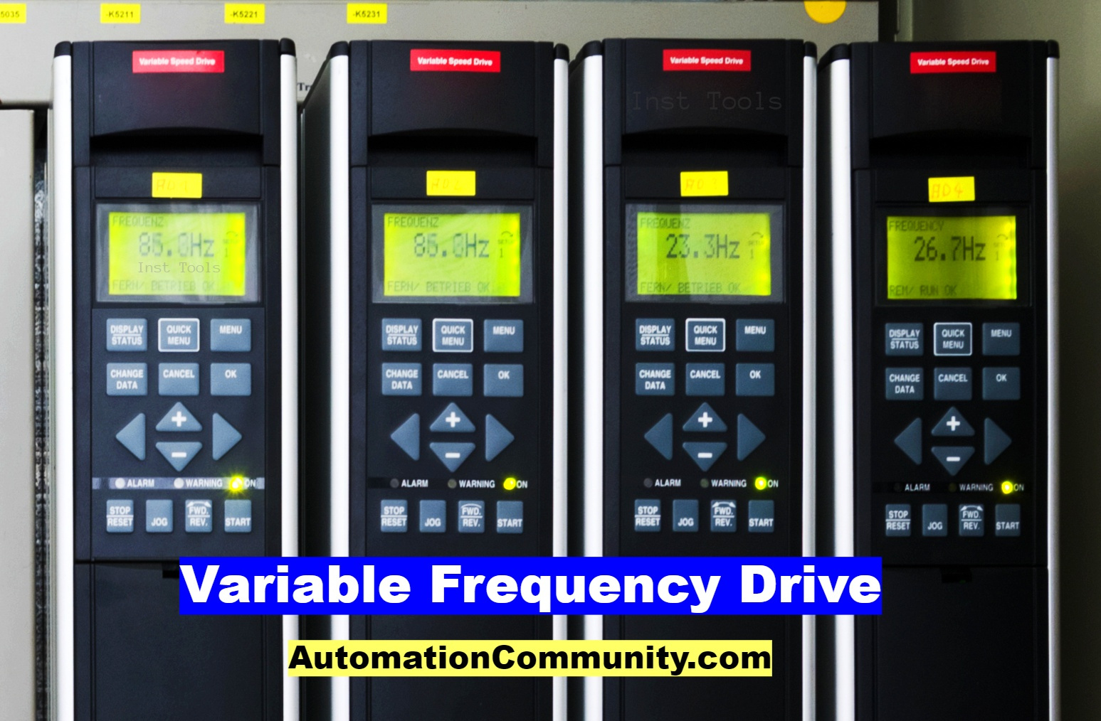
Conclusion
The successful design and implementation of the Variable Frequency Drive (VFD) project have yielded valuable insights into the realm of power electronics and motor control. By effectively integrating the 220V/12V center-tap transformer, CD4047BCM oscillator, and IRF540 MOSFET, we have demonstrated the feasibility of achieving variable frequency operation within the designated range of 30 Hz to 55 Hz. The project's success highlights the potential of energy-efficient motor control systems in industrial and commercial applications, where precise speed regulation and energy savings are paramount.

Slide 20
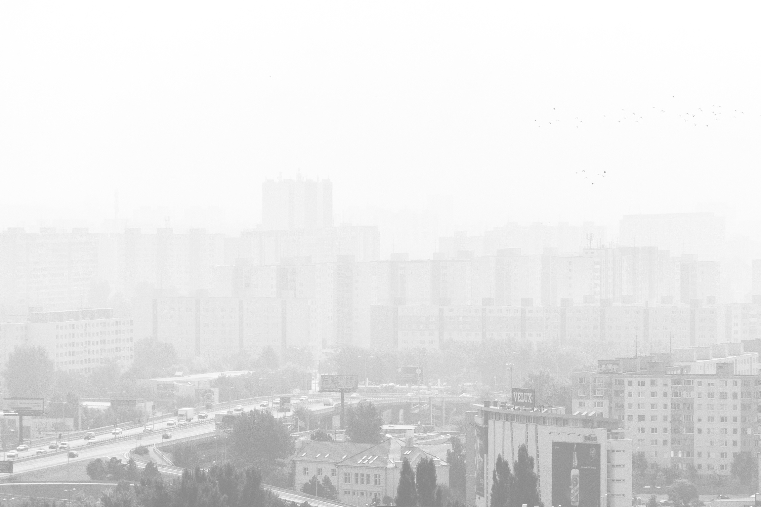

Ahsanullah University of Science and Technology
Thank You
For Your Attention
www.aust.edu

